Slide 1


Slide 2
What is Stream Processing?
Continuously incorporating new data to compute result
Input data is unbound – no predetermined beginning or end
User application
Compute various queries
Outputs multiple versions of result
Keep in external sink

Slide 3
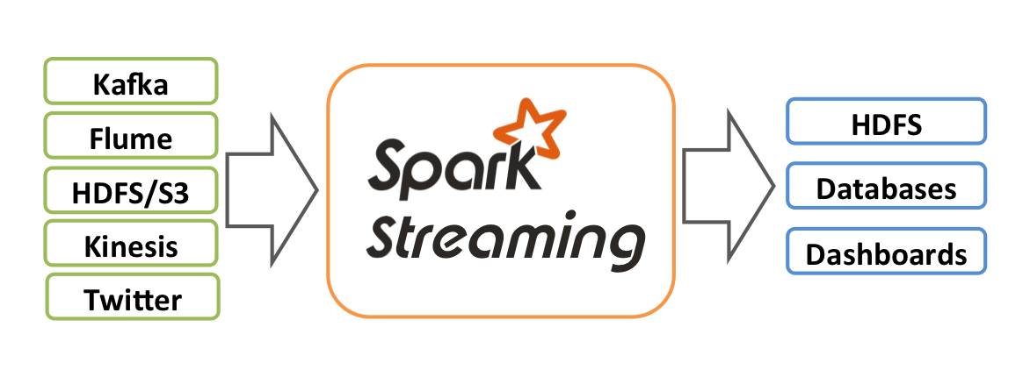

Slide 4
Stream processing Use Cases
Notification and alerting
Real-time reporting
Update data to serve in real time
Real-time decision making
Online machine learning

Slide 5
Advantages of Stream Processing
Enables lower latency – decision making, alerting systems
Efficient in updating the result

Slide 6
Challenges of Stream processing
Processing out-of-order data based on application timestamps
Maintaining large amounts of state
Supporting high-data throughput
Handling load imbalance
Responding to events at low latency
Joining with external data in other storage systems
Determining how to update output sinks as new events arrive
Writing data transactionally to output systems
Updating your application’s business logic at runtime

Slide 7
Continuous Execution
In continuous processing-based systems, each node in the system is continually listening to messages from other nodes and outputting new updates to its child nodes
Processing happens on each individual record

Slide 8
Continuous Execution
Advantage
Offers lowest possible latency for relatively low input rate
Disadvantage
Lower throughput (significant amount of overhead per-record)
Load balancing difficult because of fixed topology of operators

Slide 9
Micro-Batch Execution
Wait to accumulate small batches of input data, then process each batch in parallel using a distributed collection of tasks

Slide 10
Micro-Batch Execution
Advantage
Micro-batch systems can often achieve high throughput per node
Micro-batch systems can also use dynamic load balancing techniques to handle changing workloads
Disadvantage
a higher base latency due to waiting to accumulate a micro-batch.

Slide 11
Spark’s Streaming APIs
The DStream API
Structured Streaming API

Slide 12
DStream
Spark’s original DStream API has been used broadly for stream processing since its first release in 2012
Based purely on Java/Python objects and functions, as opposed to the richer concept of structured tables in DataFrames and Datasets
API is purely based on processing time—to handle event-time operations, applications need to implement them on their own
Only operate in a micro-batch fashion

Slide 13
Structured Streaming
Structured Streaming is a higher-level streaming API built from the ground up on Spark’s Structured APIs.
Structured Streaming can perform more types of optimizations automatically
Structured Streaming has native support for event time data
Runs on both Continuous and Micro-Batch execution model

Slide 14
Structured Stream Basics

Slide 15
Core Concepts
Transformations and Action
Input Sources
Apache Kafka
Files on a distributed file system like HDFS or S3
A socket source for testing
Sinks
Apache Kafka
Almost any file format
A console sink for testing
A memory sink for debugging

Slide 16
Output Modes: How data is output
Append (only add new records to the output sink)
Update (update changed records in place)
Complete (rewrite the full output)
Triggers: When the data is output
will look for new input records as soon as it has finished processing the last group of input data
also supports triggers based on processing time (only look for new data at a fixed interval)

Slide 17
Event-Time Processing
Processing data based on timestamps included in the record that may arrive out of order
Watermarks
A feature of streaming systems that allow you to specify how late they expect to see data in event time
They limit how long they need to remember old data

